Slide 1
Country Coordinating Mechanism Positioning
ALBANIA

Slide 2
Key findings and conclusions from the mapping exercise
13 Tetor 2022

Slide 3
CCM Positioning journey: Coordination, Sustainable Structure
Positioning, how the CCM finds its optimal place relation to decision making in the broader health system
What is positioning
Ensuring national ownership and country – led implementation
Participation , through creating , developing and expanding partnerships among all relevant stakeholders
Alignment with national health governance
Inclusion , through transparent governing processes which give a voice to key affected population

Slide 4
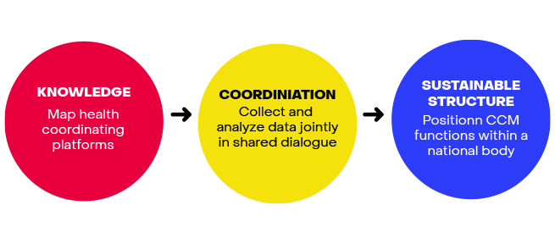
Positioning

Slide 5
Coordination
The CCM should implement
Information sharing
Enhancing joint data collection @ analysis including through community based platforms
Joint meeting
Organizing meeting or inviting delegates from other platforms to CCM meeting as observers and vice versa
Shared membership
To promote joint oversight of different health programs and improve overall function in overlapping areas
Joint secretariat function
Sharing certain secretariat functions i.e support on program oversight
Aligned Governance policies
Promoting action representation of civil society by aligning policies and principles with other coordinating platforms

Slide 6
Knowledge
How they work
Analyzing their different compositions roles and structures
How responsibilities and distributed
Assessing the relationship between exiting coordinating platforms the CCM and national policy makers
Where the CCM stands
Determining whether the current setting allows the CCM to be the most effective in the fight against the diseases
Where the CCM should stand?
Analyzing the current setting to identify where CCM functions should be positioned to the most effective
How to get here

Slide 7
Sustainable structure
The CCM should embed its function through
Structure
Positioning CCM functions within a new standalone institution or substructure of a wider national health platform
Sustainability
Defining a new CCM scope and applying CCM principles to health governance in the long term
Governance
Revising CCM governance manuals to incorporate new procedures
Membership
Defining a new CCM membership ensuring representation of all relevant stakeholders

Slide 8
10 health institutions were selected for the review of documents that are directly related to TB and HIV services

Slide 9
University Hospital “Shefqet Ndroqi”
The meeting in the SUSHN for the management of TB in the country key points were: shto persoant e takimit
Hospitalization of TB patients
Difficulties encountered with TB patients during the pandemic Covid -19
Problems encountered in the TB reference laboratory
The process of procuring TB drugs
Difficulties with the management of patients with resistance to TB
Distribution and monitoring of TB drugs
Difficulties about the TB budget
Registration and reporting of TB cases
Testing TB patients for HIV
The role of SUSHN in the transition process, including all the components that the global fund has invested in the field of TB.

Slide 10
Institute of Public Health
The role of the TB Program in TB control, challenges, barriers and gaps
The role of the HIV Program in HIV control, challenges, barriers and gaps
TB/HIV co-infection management, identified problems
Monitoring and evaluation process, findings and recommendation
The role of PIH in the transition process, including all the components that the global fund has invested in the field of TB and HIV

Slide 11
Department of Pediatric QSUT
Management of children with TB, challenges, barriers and gaps during the COvid-19 pandemic
New pediatric first- and second-line TB doses
Prevention and contact tracing for member family and other contact
Update new guidelines for TB pediatrician, support by WHO.
Strength collaboration with other pediatricians in districts
Requests every year for the procurement of TB drugs should come from the respective specialists based on the guidelines of TB children
Assistance in TB drug quantification and forecasting
Responsible for the management and distribution of TB medicines to TB children patients.

Slide 12
Compulsory health insurance
The Compulsory Health Insurance Fund (CHIF) pays for the services provided by all facilities, including the UHSN and the University Hospital Centre “Mother Teresa” (UHCMT), the regional hospitals and the PHC providers; the pulmonology dispensaries are under the administration of the regional hospitals.
Financing health care services through compulsory and voluntary insurance payments and based on principles of universal access, solidarity, efficiency and quality, free choice of doctor, partnership
Undertakes annual contracts with public and private healthcare providers for the delivery of healthcare packages.
Pays the visits, examinations and medical treatments by public and private providers of primary (except community centres), secondary and tertiary care.
Pays the medicines (list of reimbursable), products and medical treatments prescribed by a contracted healthcare provider

Slide 13
Operator of center Health
For the approval of the internal regulation for the way of organization, the approval of the internal regulation for the way of organization and operation of the operator of health care services".
Dissemination of information about TB guidelines for the inclusion of TB in primary health care.
Monitoring the quality of services throughout the country for TB and HIV diseases
Monitoring for the implementation of the TB guidelines in the primary health service personnel.
Difficulties and barriers encountered during the COvid-19 pandemic
Budget management of centers in primary health care and how focused they are on determining the budget for TB and HIV services.

Slide 14
General directorate of prisons
TB control in prisons, problems and challenges
Cooperation with the prison hospital for the hospitalization and treatment of TB patients who are incarcerated and their follow-up when they leave the prison if they are being treated for TB.
Cooperation with the TB Reference Laboratory for performing TB examinations
Cooperation with the NATIONAL TB and HIV Program for support regarding the control of TB and HIV in prisons, since during the pandemic it was not at the right level due to the problems created by COvid-19.
Discussion on the focus on the budget allocated for the control of TB and HIV in prisons
The system of reporting TB and HIV cases in the respective programs.

Slide 15
University Maternity Hospital
To focus on increasing the accessibility and quality of neonatal and pediatric primary health care
to create innovative national health policies that address the needs of the healthcare system
Additional funding and resources have also been allocated to the nation’s health sector.
to increase access to essential health care for mothers and children, works to prevent malnutrition and weight-related disorders
to prevent infectious diseases and reduces infection rates of HIV/AIDS and other sexually transmitted diseases
strength collaboration with the National TB Program for TB prevention including all elements of TB control

Slide 16
WHO regional office
WHO provides technical assistance through the national professional officer, will be responsible for enhancing HIV, HIV-related TB (HIV/TB) and TB services among vulnerable populations
Provide technical assistance for the review of relevant and priority national policies regarding HIV surveillance, testing, treatment and care.
Provide technical assistance for the assessment of basic package of HIV services for key populations, including opioid substitution therapy and other technical areas as needed.
Support the alignment of national practices with WHO recommendations on the management of HIV/TB and HIV/hepatitis, including the collaboration protocol between NAP and NTP.
Support for update guidelines TB and HIV

Slide 17
Multicipacility of Tirana (Department of health care and integrated service)
Supported MoHSP develop the new National Action Plan on the Integration of Roma and Egyptians 2021-2025 with a particular focus on integrated social care services.
Social and financial support of patients with TB and HIV
Community awareness in cooperation with the department of health care and integrated service
Establishing a partnership between TB and HIV programs to focus on patient care and support.
Strength collaboration with NGOs operating in the field of HIV and TB
Encouragement NGO to operate in the field of TB.
Strengthen the participation of communities and people, particularly those affected by the two diseases
Aim to eliminate stigmatization of and discrimination against those infected and affected by the two diseases, especially for women, children and vulnerable groups

Slide 18
Ministry of health and social protection
Drafting and implementation of policies and development strategies in the health care sector; regulation of health care services and coordination of the work among all stakeholders, both within and outside the health care system.
Guarantee of the constitutional rights for social protection and inclusion, social care and equal chances.
Planned actions/reforms to increase domestic resources for health;
Planned actions to develop a health financing strategy and/or the implementation of the existing
health financing strategy;
Increasing trends in government health expenditure;
Planned support for implementing financing reforms;
Plans to meet universal health coverage goals and objectives
Analysis of sustainability and/or transition challenges, and development and implementation of
sustainability and/or transition plans

Slide 19
From the meetings with stakeholders at the national level necessary action are:
Strengthening the capacity of public organizations providing emergency services (education, training, technical equipment, etc.)
Ensuring the sustainability of services at the level of states, donors, local budgets
Psychosocial support and counseling.
Better informed national sustainability and transition related planning processes
Key population groups more engaged in monitoring of transition related processes
Civil society have their sustainability and transition related advocacy goals
Efforts to promote transparency and accountability
Elimination of stigmatization and discrimination against those affected by the two diseases, especially vulnerable group
CCM positioning and alignment with national structures to strengthen implementation of Strategy's priorities TB, and HIV
Partnerships amongst all stakeholders within a country, where all members have an equal voice

Slide 20
Key important of our work on sustainability, transition and co-financing:
Support countries to develop robust national health strategies, health financing strategies and national disease strategic plans
Encourage additional domestic investments;
Accelerate efforts to prepare for transition,
Strengthen focus on key populations and structural barriers to health
Work with partners to advocate for programmatic and financial changes
Support countries to identify efficiencies and optimize disease responses
Strengthen alignment between Global Fund grants and country systems
The response should also include a description of the key actions to support transition from Global Fund funding and strengthen sustainability of programs.
Analysis of sustainability and/or transition challenges, and development and implementation of sustainability and/or transition plans.

Slide 21
Departamenti i Pediatrisë QSUT
Menaxhimi i fëmijëve me TB, sfidat, barrierat dhe boshllëqet gjatë pandemisë Covid-19
Doza të reja pediatrike të TB të linjës së parë dhe të dytë
Parandalimi dhe gjurmimi i kontakteve për anëtarët e familjes dhe kontakte të tjera
Përditësimi i udhëzimeve të reja për pediatrin e TB, me mbështetje nga OBSH.
Forcimi i bashkëpunimit me pediatër të tjerë në rrethe
Kërkesat çdo vit për blerjen e barnave kundër tuberkulozit duhet të vijnë nga specialistët përkatës bazuar në udhëzimet e fëmijëve me tuberkuloz.
Asistencë në kuantifikimin dhe parashikimin e barnave kundër TB per femije
Përgjegjës për menaxhimin dhe shpërndarjen e barnave kundër tuberkulozit tek pacientët e fëmijëve me tuberkuloz ne rrethe pais derit ani esht ene mnyre te centalizuar . Kjo kerkon se pari trajnim te pediatereve me rrethe

Slide 22
Drejtoria e Përgjithshme e Burgjeve
Kontrolli i TB në burgje, probleme dhe sfida
Bashkëpunimi me spitalin e burgut për shtrimin dhe trajtimin e pacientëve me tuberkuloz që janë të burgosur dhe ndjekja e tyre kur dalin nga burgu nëse trajtohen për TBC.
Bashkëpunimi me Laboratorin e Referencës së TB për kryerjen e ekzaminimeve të TB
Bashkëpunimi me Programin Kombetar për TB dhe HIV për mbështetje në lidhje me kontrollin e TB dhe HIV në burgje, pasi gjatë pandemisë nuk ishte në nivelin e duhur për shkak të problemeve të krijuara nga Covid-19.
Diskutim mbi fokusin në buxhetin e akorduar për kontrollin e TB dhe HIV në burgje
Sistemi i raportimit të rasteve të TB dhe HIV në programet përkatëse.
Mungesa e mjekut pneumolog ne spitalin e burgut

Slide 23
Materniteti I ri
Të fokusohet në rritjen e aksesueshmërisë dhe cilësisë së kujdesit shëndetësor neonatal dhe pediatric për të krijuar politika kombëtare shëndetësore inovative që adresojnë nevojat e sistemit të kujdesit shëndetësor
Mbeshtetje për të rritur aksesin në kujdesin thelbësor shëndetësor për nënat dhe fëmijët,
për të parandaluar sëmundjet infektive dhe për të reduktuar shkallën e infektimit me HIV/AIDS dhe sëmundje të tjera seksualisht të transmetueshme
bashkëpunimi i fortë me Programin Kombëtar të TB për parandalimin e TB-së duke përfshirë të gjithë elementët e kontrollit të TB-së
Përditësimi i udhëzimeve për menaxhimin e rasteve me HIV për nënat dhe fëmijët,sidurimi I medikamenteve te nevojshme per nenat me Hiv dhe per femijet

Slide 24
Nga takimet me palët e interesuara në nivel kombëtar, veprimet e nevojshme janë
Sigurimi i qëndrueshmërisë së shërbimeve
Mbështetje dhe këshillim psikosocial.
Përpjekjet për të promovuar transparencën dhe llogaridhënien
Eliminimi i stigmatizimit dhe diskriminimit ndaj të prekurve nga dy sëmundjet, veçanërisht grupeve vulnerabel
Grupet kryesore të popullsisë janë më të angazhuara në monitorimin e proceseve të lidhura me tranzicionin
Shoqëria civile ka objektivat e saj të avokimit lidhur me qëndrueshmërinë dhe tranzicionin

Slide 25
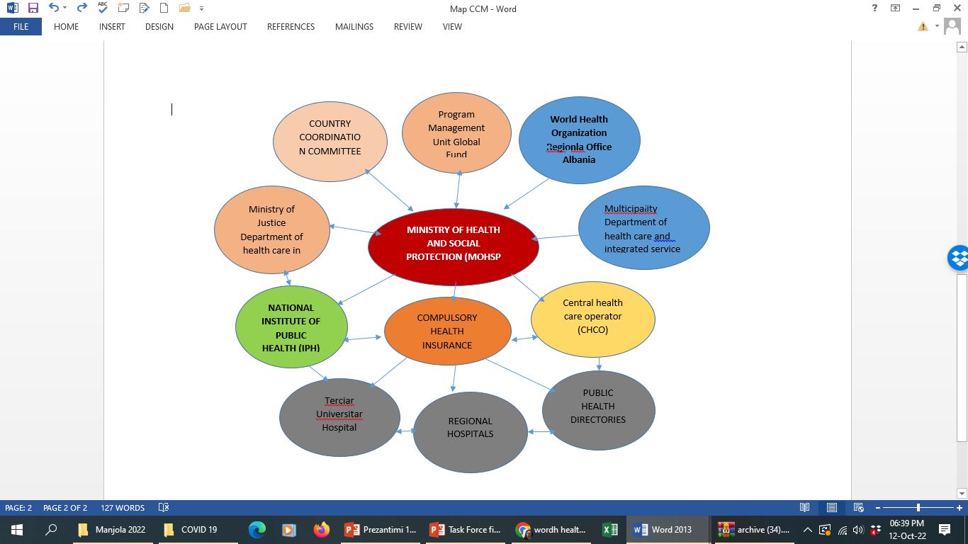
Example of Map

