Slide 1
Meeting with representatives of National Health Institutions and other partners for development of positioning options and a strategic positioning plan to help strengthening CCM country's position
Hotel Tirana
2 June 2023

Slide 3
Group 1 ( clinical)
University Hospital “Shefqet Ndroqi
University Maternity Hospital
Department of Pediatric QSUT
General Directorate of Prisons

Slide 4
A. Topics for Group Discussion
What are the services covered by your institution regarding TB and HIV?
Have you encountered problems in providing services for TB and HIV?
How many of these services does Global Fund cover?
What action plan do you think for the sustainability of these services after the completion of the Global fund project?

Slide 5
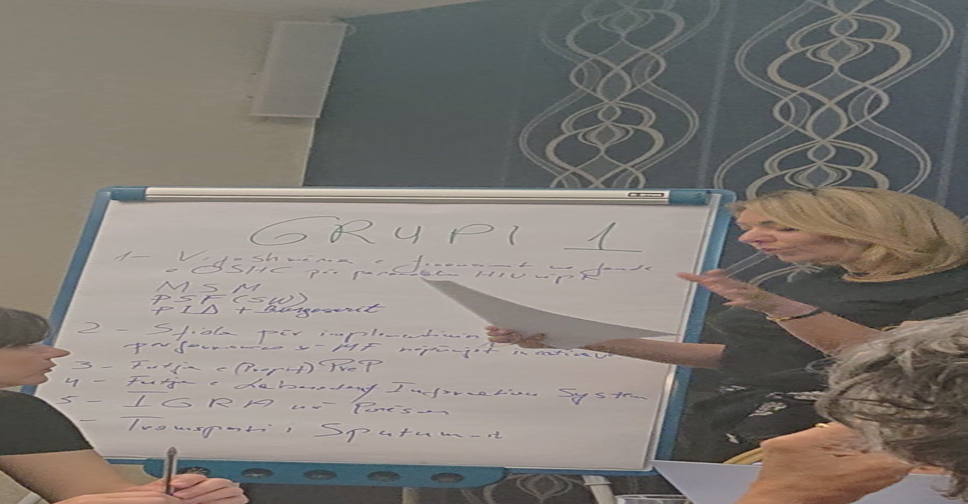
Working group 1

Slide 6
Group 2 (Health system care)
Compulsory Health Insurance
Operator Of Center Health
Institute of Public Health
Ministry of Health and Social Protection

Slide 7
B.Topics for Group Discussion
Discussion on funding for TB and HIV prevention, diagnosis and treatment services from the respective institutions
Cost effectiveness for TB patients and TB and HIV
Proposing a comprehensive funding plan for the continuation of TB and HIV services, taking into account the funding of relevant activities, including equipment, reagents, training, to address issues related to the laboratory as well as the maintenance of health equipment, etc.

Slide 8
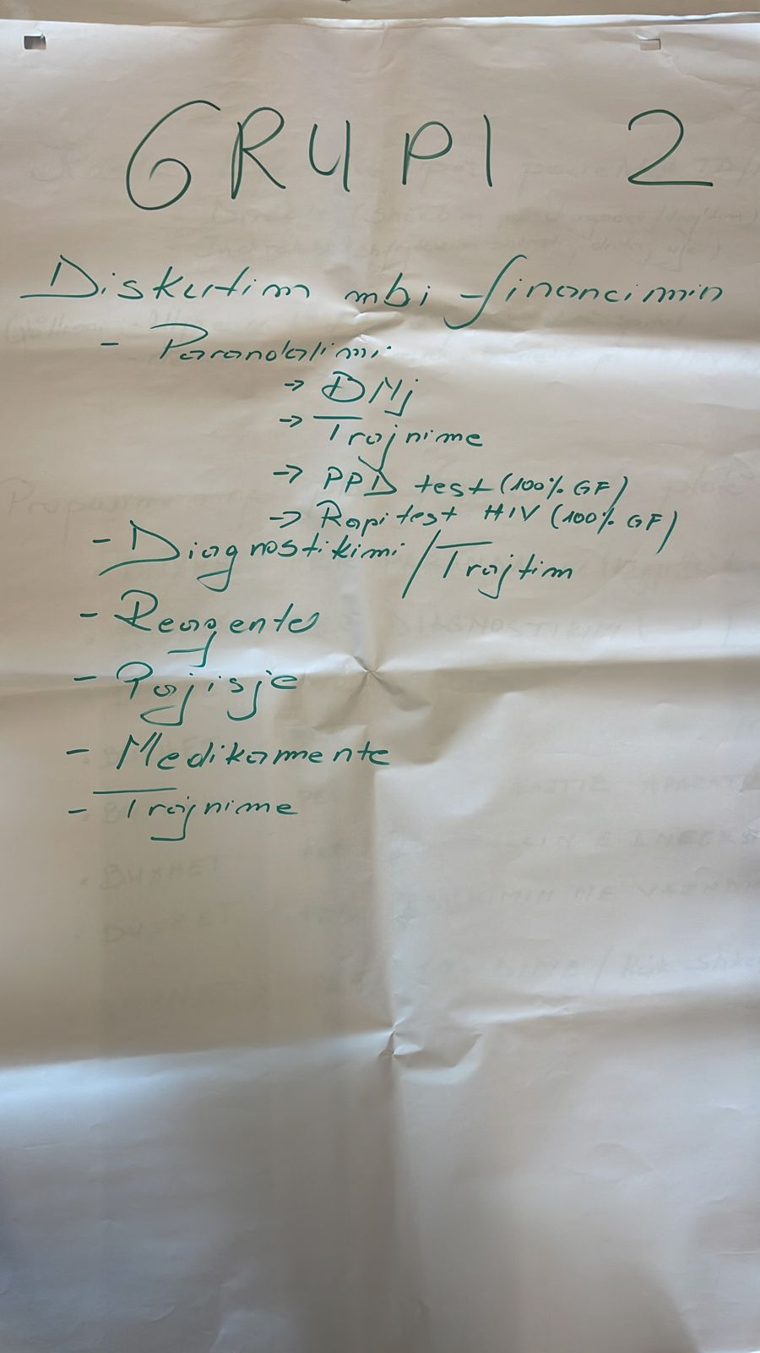
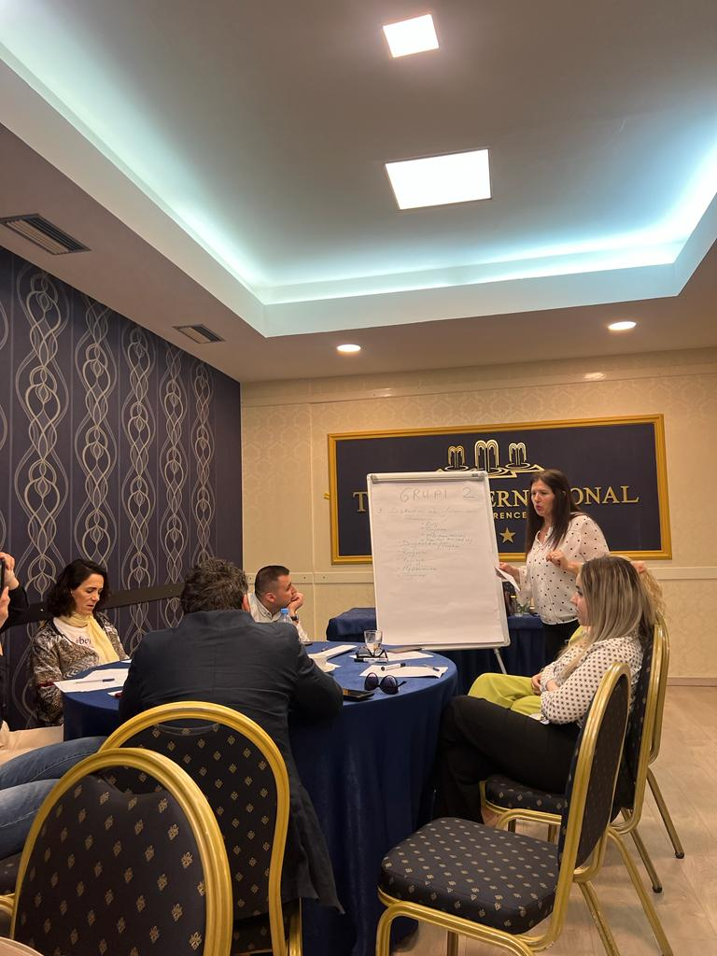
Working group 2

Slide 9
Group 3 ( partnerships)
WHO Regional Office
Municipality of Tirana
Civil society focus TB
Civil society focus HIV

Slide 10
C.Topics for Group Discussion
Is the commitment of the community in the care and control of TB and HIV at the right level?
How can community involvement help in the treatment of TB and HIV?
What are the barriers encountered by CSO?
Support of CSO for TB and HIV from municipalities
WHO's role in supporting a patient-centered approach to TB care

Slide 11
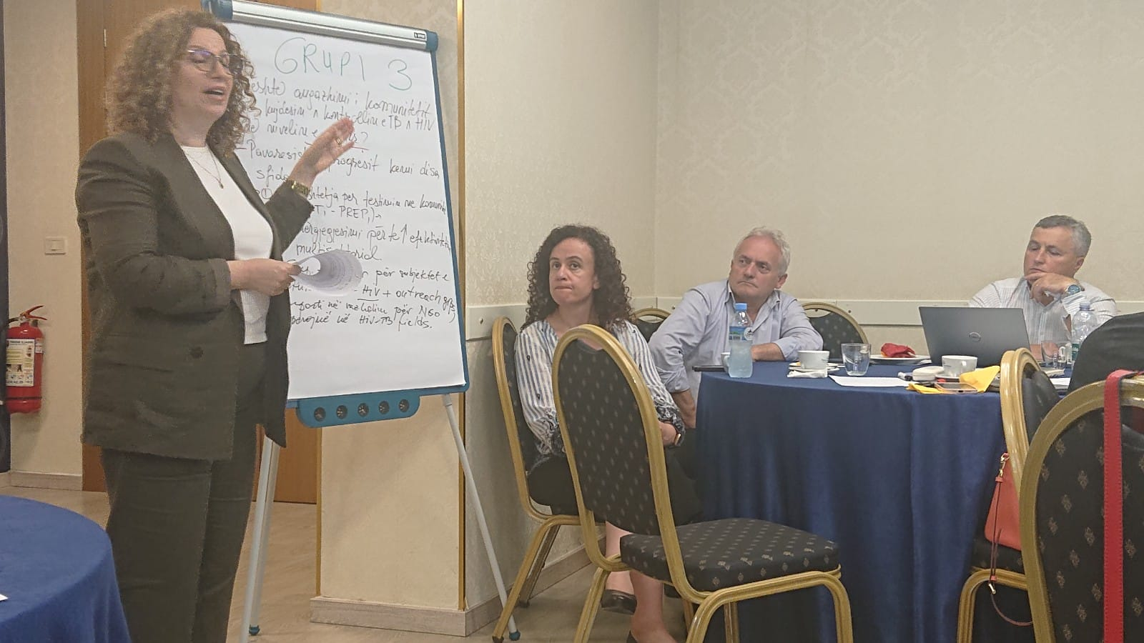
Working group 3

Slide 12
Group 4 (Political decision making)
University Hospital “Shefqet Ndroqi”
Institute of Public Health
Ministry of Health and Social Protection
Ministry of Finance
Civil society

Slide 13
D.Topics for Group Discussion
Institutional readiness
The role of CCM
Factors for increasing access
Proposals for drafting a transition plan for TB and HIV

Slide 14
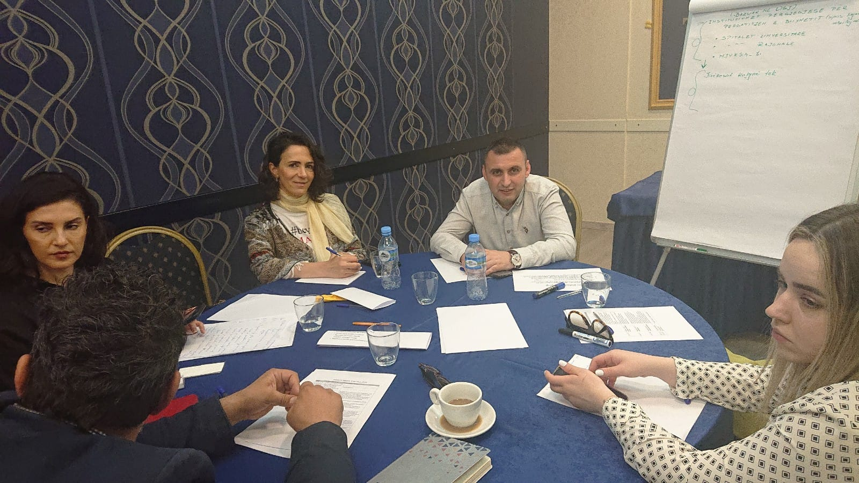
Working group 4

Slide 15
PRIORITY ACTIONS
Strengthening inter-institutional cooperation
Emphasis on financial support for integrated services
Ensure that the full costs of the TB and HIV program
Engage with the private sector and other stakeholders in the TB and HIV response
Description and budget of any activities essential to enable a successful TB and HIV transition

Slide 16
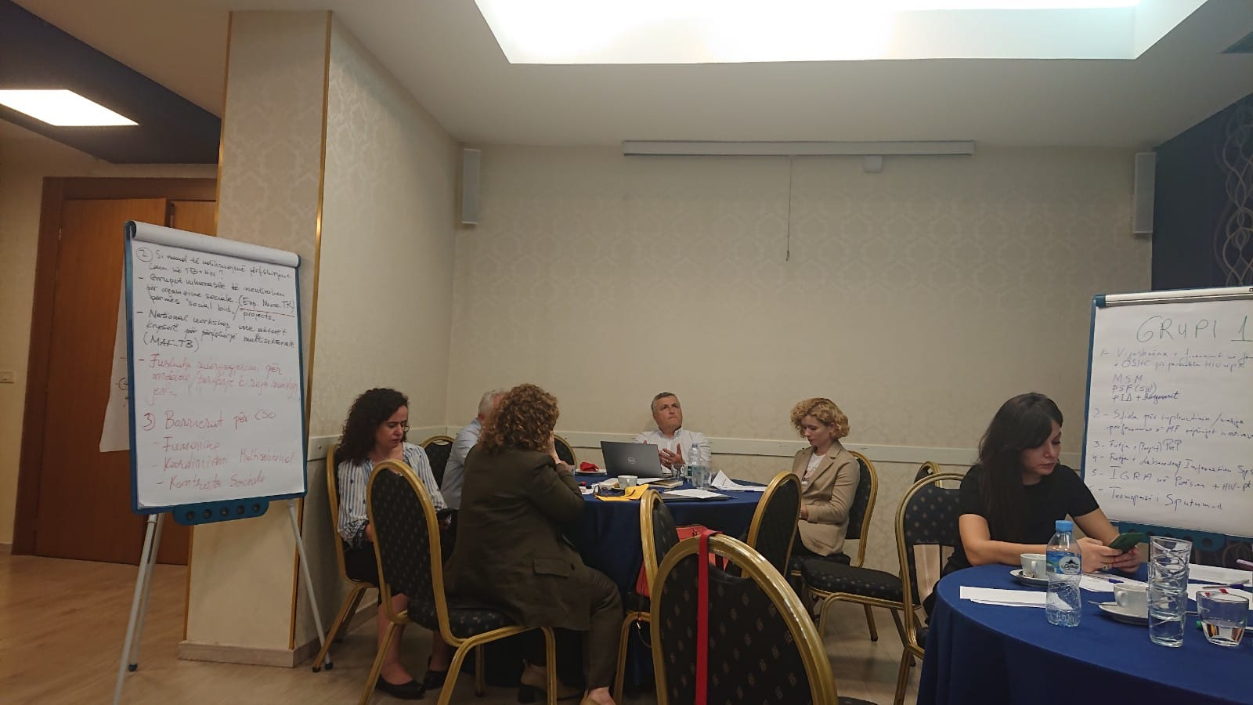
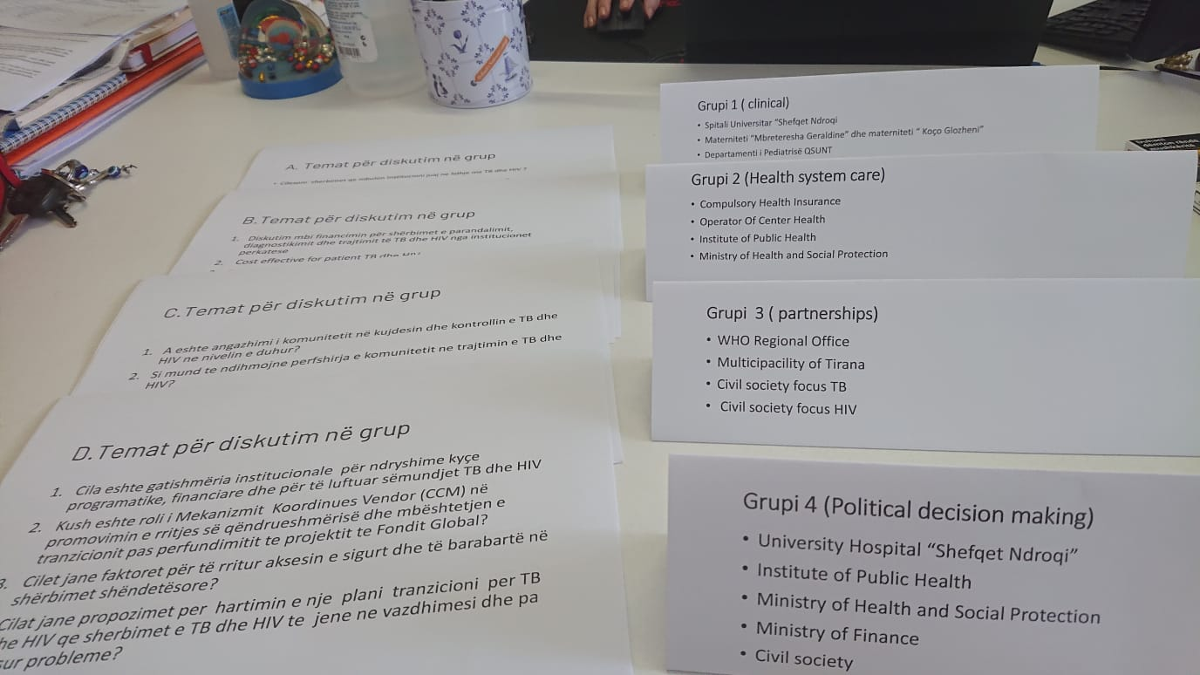
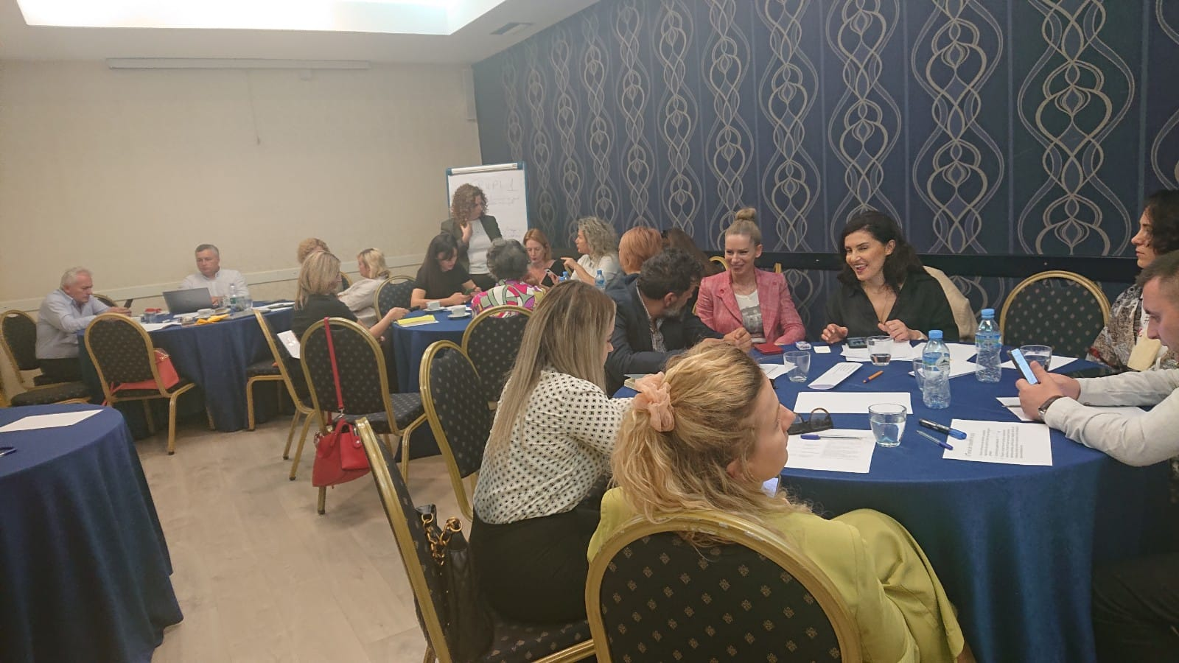
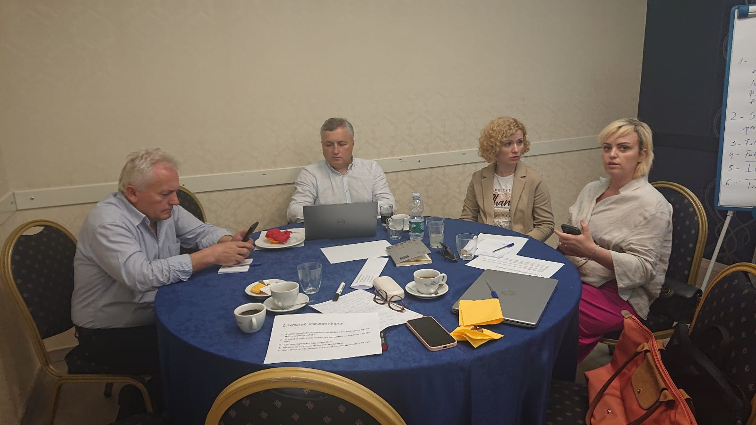
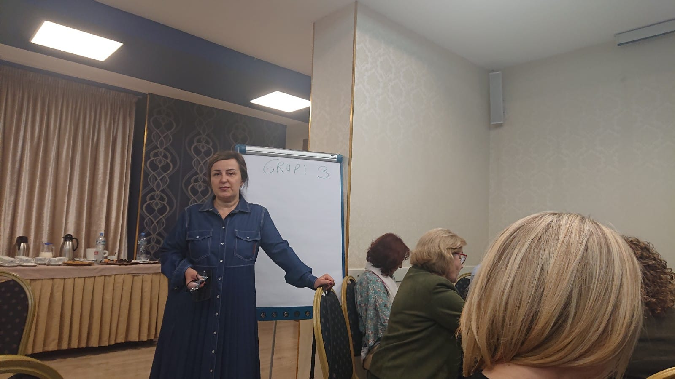
Thank you for your work

